Slide 1
Gosco 3-Way Diverter Valves

Slide 2
The Gosco Valves Approach
^{Knowing client needs}
^{Understanding the process}
^{Custom design}
^{In-house manufacturing}
^{After-sale service}
Notes:
The Gosco Valves Approach:
Our customers’ feedback has been that we deliver outstanding value in the following areas:
Knowing client needs:
We need to know what is important to the customer e.g. price, delivery, performance, warranty, their customers etc
We provide site visits, consultation, problem solving and are extraordinarily responsive to customers’ needs
We listen to customer needs and provide a solution to their problems
Commitment to service both before and after the customer has purchased our valves
Understanding the process: Our valve is custom made and designed specifically for the application, so we need to know as much as possible about the process so that we can provide the best solution. We need to know pressures, temperatures, chemical breakdown, molecular structure, particle size, how they damage other valves etc
Custom design:
We provide excellent back-up information such as finite element analysis, computational fluid design, 3D solid models, and engineering support
Every valve is designed specifically for the application
In-house manufacturing:
We have global manufacturing capabilities, but we are also able to manufacture every component of the valves in-house
We are ISO certified
We design our valves in accordance with the following codes & specifications: ASME, API, CSA, CRN, ISO 9000, TÜV, customer specified
After-sale service:
With an exceptional product, must come exceptional service. We guarantee that will make it right at all costs. We will also be proactive ad make site visits to make sure our customers are happy with the Gosco experience

Slide 3
Gosco 3-Way Diverter Valves
^{Readily available}
^{Completely customizable}
^{Extremely durable}
^{Competitively priced}
Notes:
Gosco 3-Way Diverter Valves:
Our 3-Way Diverter Valves are:
Readily available:
Our shelves are regularly stocked with major components and standard deliveries are 2-3 weeks
Completely customizable:
Our valves are tailored to your application. We offer all the standard options (end connections, seats, packing etc) as well as metal seats, exotic alloys, 3-way diverters, block and bleed, FM approved, and cryogenic
Extremely durable:
We offer a 1 year warranty or 1,000,000 cycles on the stem packing. Many of our valves have remained in service for more than 20 years.
Competitively priced:
Compared to similar quality valves, we are competitively priced and often less money. Our valve pricing reflects the high quality materials and professional engineering inherent in every Gosco valve

Slide 4
Gosco 3-Way Diverter Valve Features
^{Live loaded seats}
^{Unrivaled shaft sealing}
^{Patented Sealmaster system}
^{Live loaded construction}
Clearview ISO 5211 mounting pad
^{Extended bonnet}
Notes:
Gosco 3-Way Diverter Valve Features:
Each of the following points will be expanded upon on the next slides

Slide 5
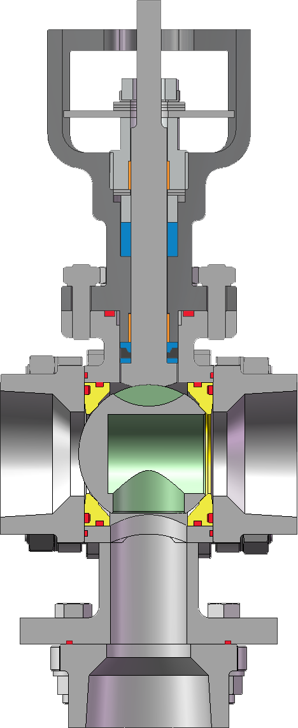
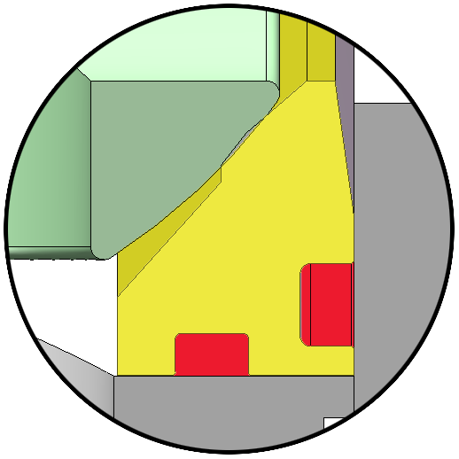
Live Loaded Seats
^{Dual O-Ring design}
^{Live loading by gland O-Ring}
Dynamic sealing by secondary O-Ring
Notes:
Live Loaded Seats:
A 3-Way Diverter valve does not use the process pressure to assist with sealing the ball and seats. On PEEK, UHMWPE and metal seats, they need to be live loaded to ensure that there is a constant load on the seats. Softer seats such as TFM 1600(2nd generation PTFE), and Teflon seats, this is not necessary.
Dual O-Ring design:
The dual O-Ring design is to provide maximum sealing for diverter applications. There are two O-rings on each seat to make sure the seats are in constant contact with the ball
Live loading by gland O-ring:
The gland O-Ring provides live loading to the seats. As seats wear, the gland O-Ring will continue to force the seat against the ball.
Dynamic sealing by secondary O-ring:
As fluid travels in to the ball, it has a tendency to push the ball upwards, off the seat. The dynamic O-Ring ensures sealing as the seat is shifted by the media pressure.

Slide 6
Shaft Sealing System
^{Dual live loaded packing sets}
^{Upper and lower shaft guides}
^{Independent packing adjustment}
Notes:
Stem Sealing System:
The Gosco stem sealing system is designed to all but eliminate stem leaks. We stand behind it with our 1,000,000 cycle warranty
Dual live loaded packing sets:
The 3-Way Diverter Valve has 2 sets of packing - graphoil or chevron Teflon at the top, and the patented Sealmaster on the bottom. Both are “Live loaded” for longer life
Upper and lower stem guides:
We also have stem guides because on a floating ball design, the line pressure forces the ball in to the downstream seat. This movement of the ball gets transferred to the stem and in conventional ball valves, it creates “side load” on the packing. The stem guides prevent the stem from shifting and then compressing the packing. This is done by holding the stem concentric and limiting packing side load. It dramatically increases packing life.
Independent packing adjustment:
Each packing set is independently adjustable to optimize the life of each packing.

Slide 7
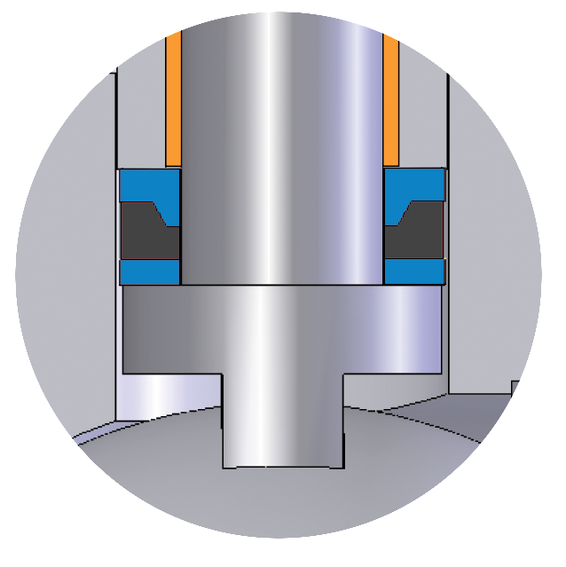
Sealmaster Shaft Seal
^{Patented design}
^{TÜV approved}
^{1,000,000 cycle guarantee}
Upper Shaft Seal
Compression Ring
Thrust Seal
Notes:
Sealmaster Stem Seal:
The Sealmaster stem seal is a unique seal that is offered on all our soft seated valves. It is comprised of 3 parts - Upper stem seal, compression ring and a thrust seal. When the Sealmaster stem seal is tightened, the compression ring (which is stainless steel) forces the upper stem seal (Teflon or PEEK) into the stem and creates a seal between the stem and body. The Sealmaster stem seal can be retightened to recommended torques.
Patented Design:
The “Sealmaster” is patented by Gosco Valves because of its unique features that give it such long life.
TÜV approved:
It is live loaded and has been tested by TÜV to be better than a bellows seated valve (Copy of the certificate can be provided). It exceeds all current and proposed fugitive emission standards.
1,000,000 cycle guarantee:
The stem sealing system (upper packing, sealmaster, stem guides and live loading) prevents media from leaking out of the stem. The combination of the “Sealmaster” and upper packing allows us to give a 1,000,000 cycle guarantee against packing leaks. We are the only company in the world to offer this guarantee.

Slide 8
Live Loaded Construction
^{Live loaded bonnet}
^{Live loaded end caps}
^{Studs instead of bolts}
Notes:
Live loaded construction:
We use belleville washers on all bolting connections to compensate for pressure and temperature fluctuations, as well as vibration.
Live loaded bonnet:
Bellevilles on the bonnet connections
Live loaded end caps:
Bellevilles on the end cap connections
Studs instead of bolts:
Studs are stronger than through-bolting or cap screws.

Slide 9
Clearview Mounting Pad
Dual ISO 5211 mounting patterns
^{Shaft Flats Visible}
Packing adjustments above insulation
Actuator is kept away from hot valve
Notes:
Clearview Mounting Pad:
The Clearview mounting pad is designed to eliminate the problems with traditional mounting pads. It is a unique design, patented by Gosco Valves
Dual ISO 5211 mounting patterns:
On most sizes, we offer dual ISO 5211 mounting configurations
Stem Flats visible:
The “Double D” stem indicates the valve position and is visible even if an actuator or insulation is installed.
Packing adjustments above insulation:
Packing adjustments are located above the insulation to allow full accessibility without removing the actuator or the insulation.
Actuator is kept away from hot valve:
The actuator is raised away from elevated process conditions and is protected from excessive heat.

Slide 10
Extended Bonnet
Handle / actuator is outside the insulation
Packing adjustments are outside the insulation
^{Protects the operator}
Notes:
Extended Bonnet:
All Gosco’s soft seated valves have an extended bonnet. It has several advantages.
Handle / actuator is outside the insulation:
The actuator is raised away from elevated process conditions and is protected from excessive heat.
Packing adjustments are outside the insulation:
This allows full accessibility to the packing adjustments without removing the insulation
Protects the operator:
The metal cover around the insulation is not left exposed with sharp edges that can cut an operator if he needs to open or close the valve.

Slide 11
Kinetrol Actuator
^{Simple design}
^{One moving part}
Kinetrol manufactured accessories
^{Low maintenance cost}
Notes:
Kinetrol Actuator:
The Kinetrol actuator is the most reliable actuator on the market. It is a the actuator of choice for all Gosco valves
Simple design:
The Kinetrol actuator uses a vane instead of a rack and pinion. It has very few parts, so there is very little that can go wrong
One moving part:
The only moving part is the vane/shaft and as such, the actuator requires almost no maintenance
Kinetrol manufactured accessories:
Kinetrol manufactures a broad range of accessories, including spring returns, limit switches, positioners (4-20mA and 3-15 psi), electrohydraulic actuators, 180 degree actuators and dead man handles. Because they are made by Kinetrol, you can expect the same quality, fit, and design.
Low maintenance cost:
The cost of spare parts for the Kinetrol actuator is usually between 15% and 25% of the cost of the actuator, and is guaranteed for 1,000,000 cycles

Slide 12
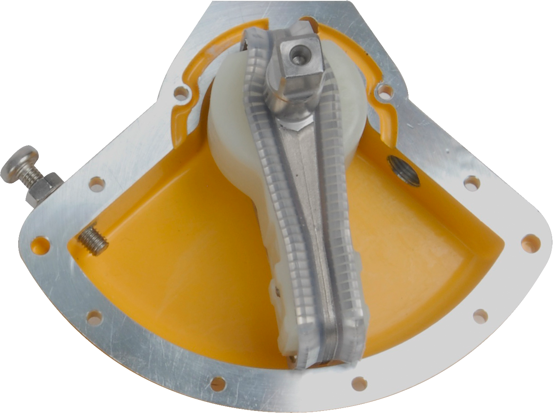
Kinetrol Vane Actuator
^{Integral vane and shaft}
^{Energy absorbent side plates}
^{Pressure assisted seals}
Stainless steel expanders for long term contact
Notes:
Kinetrol Vane Actuator:
Here is a cutaway of the actuator to show how simple it really is
Integral Vane and shaft:
It is all one piece, therefore is no hysteresis or backlash
Energy absorbent side plates:
Since the Kinetrol actuator has the fastest closing speed and highest cycle guarantee, it needs side plates to absorb the impact of the vane
Pressure assisted seals:
The seals on the vane of the actuator are pressure assisted and designed as a dynamic seal. Rack and pinion actuators use an “O” ring for their seals which is primarily used as a static seal
Stainless steel expanders for long term contact:
The expanders provide the initial load to the seals before air pressure seals the chamber

Slide 13
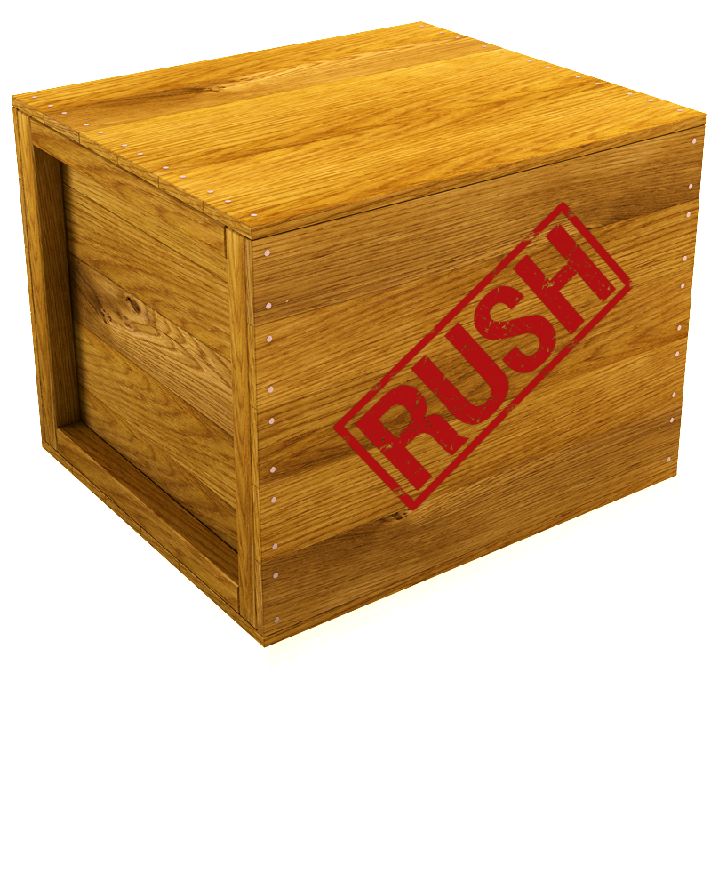
Fast Track
Expedited machining/assembly/shipping
^{Fee is based on costs incurred}
Not on time? No Fast Track charge.
Notes:
Fast Track:
Fast Track, our premium expedited ball valve service was designed to help you meet near-impossible deadlines. Available on a case-by-case basis.
Expedited machining/assembly/shipping
We examine these three aspects of your order, so we can make sure we meet your delivery requests
Fee is based on costs incurred:
The Fast Track service fee is based on accelerated engineering and design, supplier expedite charges, air freight, extra manpower and other associated costs.
Not on time? No fast track charge.
If we do not deliver in time, we will waive all Fast Track service fees

Slide 14
Design Specifications
ASME B16.34, B16.5, B16.10, B16.11, B16.20
API 608, 598
MSS SP-25, SP-54, SP-55
ASTM A193/A 194M-96b, A194/A 194M-96
CRN 0911851.34567890YT
ISO 9001:2000
Customer Specified
Notes:
Design Specifications:
Gosco meets all of the above specifications, and we can design custom valves to any specification requested by the customer

Slide 15
The Gosco Advantage
^{Designs that outperform}
^{Wide range of options}
^{Severe service specialists}
^{Exceptional customer service}
^{Superior delivery}
Notes:
The Gosco Advantage:
Gosco manufactures a very high quality valve and is extremely flexible when it comes to customer requirements
Designs that outperform:
Our valves are designed with the toughest applications in mind. We have never compromised quality in order to reduce costs
Wide range of options:
We are an industry leader when it comes to material, design and component flexibility
Severe service specialists:
We not only offer valves for standard applications but we also excel at severe service applications. This is our entry level valve line, so we can use “M Class” for more difficult applications
Exceptional customer service:
As a valve company that offers high end valves, we believe that customer service does not end when our valves leave the Gosco Valves warehouse. We recognize that customer service is a continual process that goes beyond the life cycle of our valve.
Superior delivery:
In an industry where long lead times are normal, Gosco Valves specializes in meeting near-impossible deadlines with our fast-track valve program

Slide 16
Satisfied Gosco Customers
Notes:
Noranda: Northern Quebec uses our valves on cement slurry
Bayer: Houston, Texas uses our metal seated valves on a chemical application where the media is abrasive and tends to harden if it is not moving. We designed seals to contain the belleville washers and prevent the media from getting behind the seat
Exxon: Baytown and Beaumont, Texas uses Dual Paks and metal seated double block and bleed valves
NASA: Cleveland, Ohio uses Dual Pak’s with PEEK seats on their wind tunnel to simulate the shuttle’s return to the earth’s atmosphere
Dupont: Spruance, Virgina uses our valves on all “SV” (Special valve) applications. These include TiCl, sulphuric acid, DMAC, steam and other chemicals. In 8 years, we have still not had a packing leak
ChevronPhillips: Orange, Texas uses our Dual Pak on high cycle silica (every 15 seconds). Our valves are lasting as average of 3 million cycles.
Texas Instruments: Dallas, Texas uses our valve to control caustic. Our competitors had stem leaks within weeks. The Vari V’s we installed are still not leaking after 6 years.
Husky Injection Moldings: Bolton, Ontario uses Dual Paks on their injection molding machines
ConocoPhillips: Lake Charles, Louisiana and Wood River, Illinois use our valves on their S Zorb system. It is extremely abrasive, 900F, 1000psi. Our valves have lasted 13 months to date and the competitors have been replaced on average every 2 1/2 months
General Electric: Greenville S.C. uses our valves on turbine exhaust systems at 1000F, 1000psi. 4 years without leaks

Slide 17
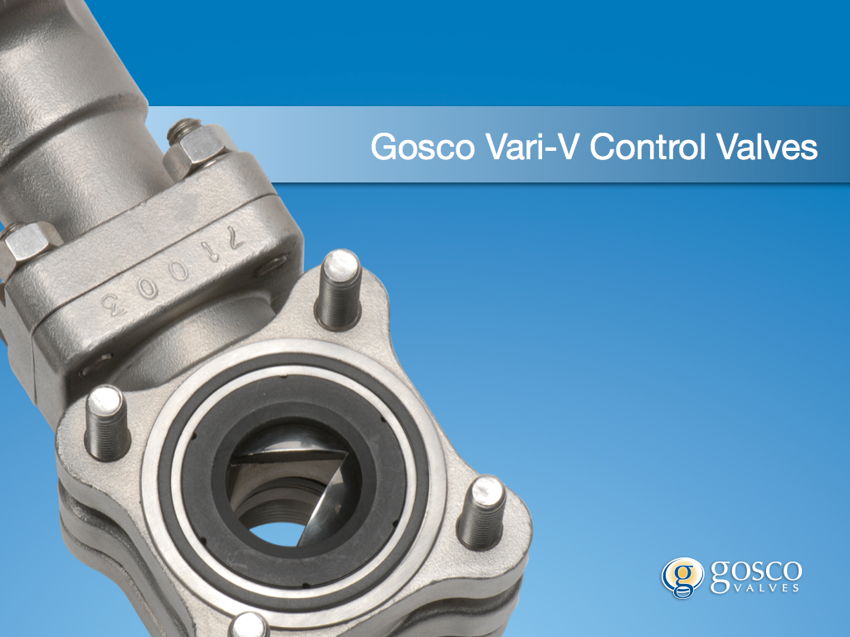
Other Gosco Products
Notes:
M-Class Valves:
Made-to-order valves for tough applications, including high temperature and high pressure applications. Metal-seated valves are offered under the M-Class valve line.
Dual Pak Ball Valves:
The standard Gosco Valves offering, with anything but standard features. Many material, design, and build options available.
Vari-V Valves:
Control valves with a profile “V” cut into the ball to provide greater degree of control of flow
Cryogenic Valves:
This is our line of valves designed for extremely low temperatures. Our cryogenic valves can go to -270C and are available with 150#, 300#, NOT, SWE or BWE.
FM Safety Shut Off Valves:
Our Dual Pak valves have been tested and approved by FM and are approved in more combinations than any of our competitors.
Block and Bleed Valves:
Our Block and Bleed Valves feature Dual Pak Ball Valve technology, and come in single, double and double integral configurations.

