Slide 1
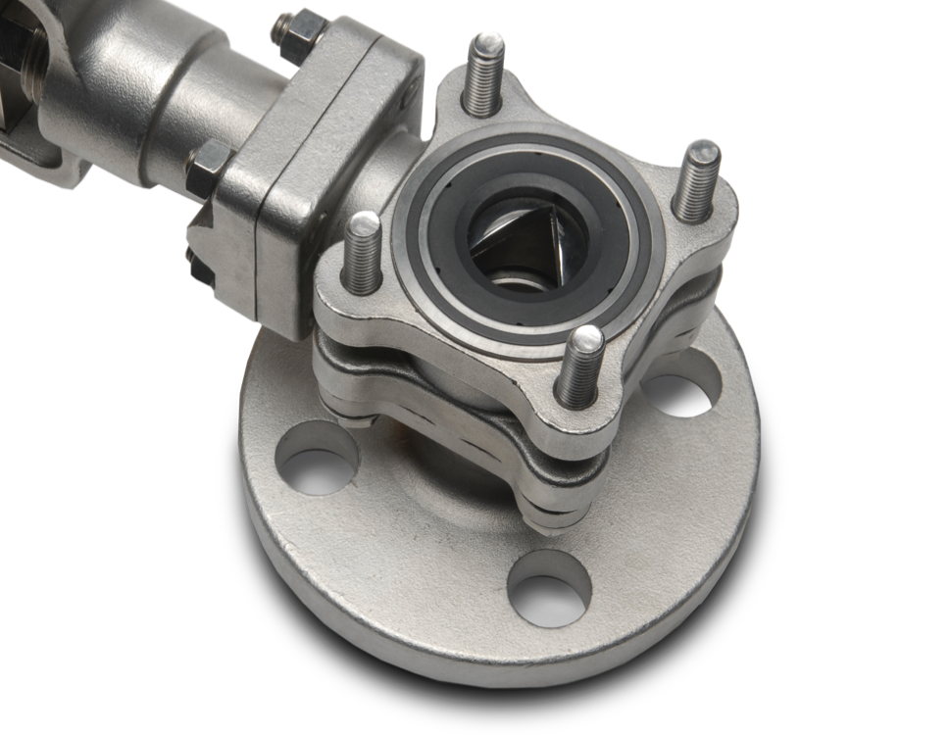
Vari-V Control Valves

Slide 2
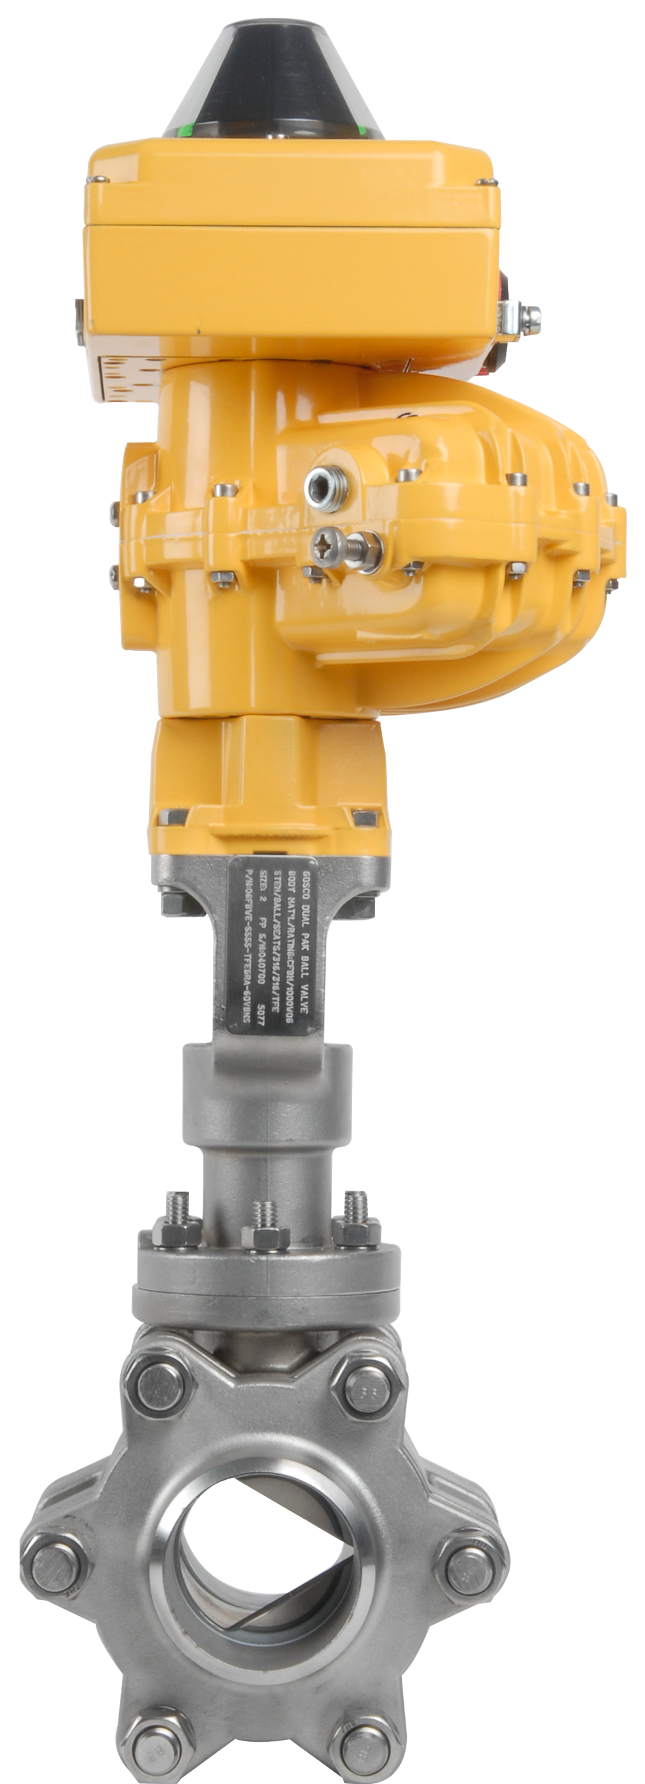
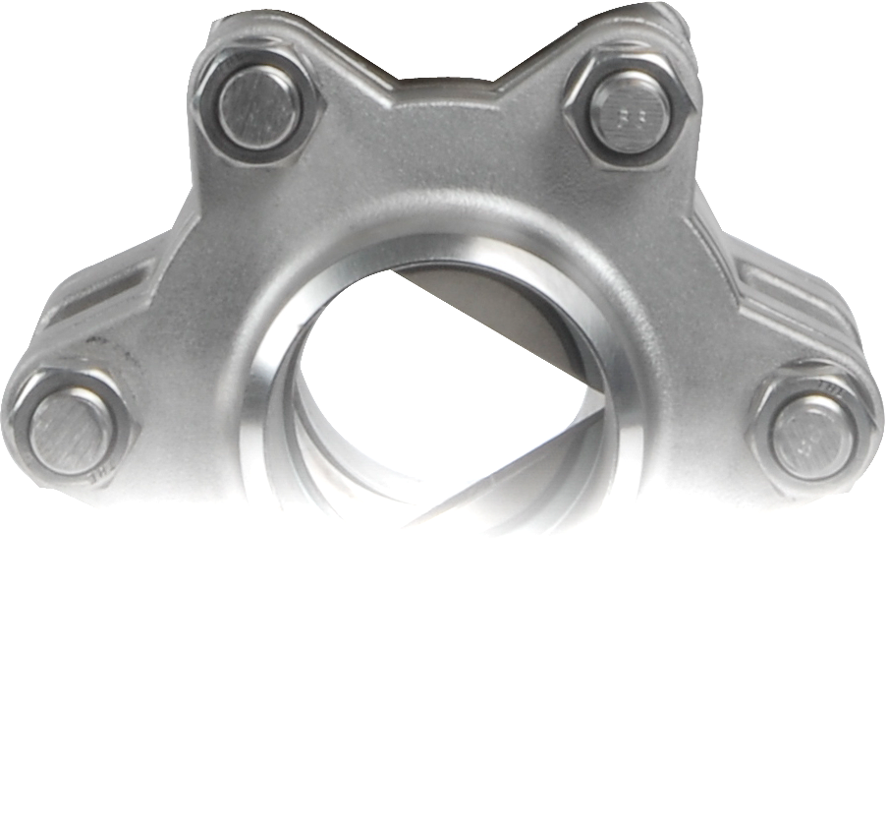
Vari-V Valves
NPS ½ to NPS 16 (DN 15 to DN 400)
-270ºC / -454ºF (Min) to 260ºC / 500ºF (Max)
Up to and above Class 4500
Most extreme applications
S-CLASS
“FLEXIBILITY & PERFORMANCE”
CUSTOM SOFT SEATED
Notes:
NPS 1/2 to NPS 16 (DN 15 to DN 400):
Valves up to 10” is our standard offering, we have made valves up to 16”, and we have the capabilities to do larger sizes.
-270ºC/-454ºF (Min) to 260ºC/500ºF (Max):
Note, these are upper and lower limits. To achieve -270ºC/-454ºF we would need a cryogenic extension and encapsulated seats. For 260ºC/500ºF, we would need encapsulated PEEK or graphite seats.
Up to and above Class 4500:
Valves up to 6” in Class 1500 is our standard offering. We have the capabilities to go to higher pressures, and we have made valves for 15,000 psi service, even though ASME B16.34 is limited to Class 4500. In cases where we exceed ASME B16.34, we reference the Pressure Vessel Code and show general engineering principals to prove the wall thickness and bolting.
Most extreme applications:
Not all soft seated valves are created equally. S-Class valves are Gosco’s flagship line of soft seated valves, and are designed to be used in extreme applications. They are most effective when there’s a combination of abrasive/corrosive applications with extreme pressures and temperatures.

Slide 3
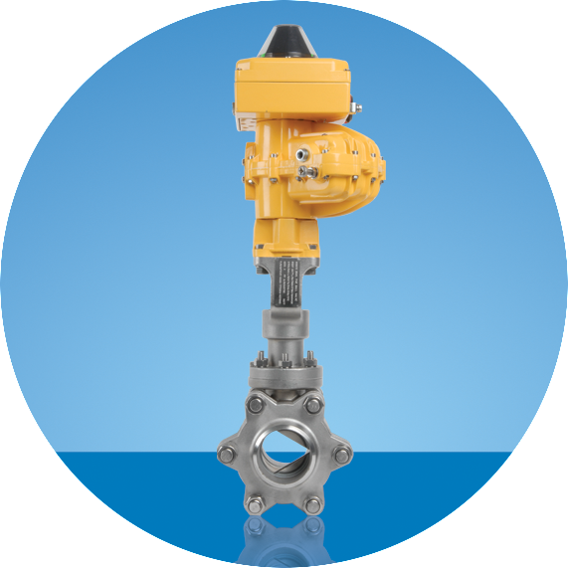
S-Class Standard Features
^{Shaft Sealing System}
^{Fugitive Emissions Port}
^{Extended Bonnet}
^{Clearview Mounting Pad}
^{Exotic Alloy Options}
^{Arcuate Cut/Vari-V Balls}
^{Hardened Ball Options}
^{Encapsulated Seats}
S-CLASS
“FLEXIBILITY & PERFORMANCE”
CUSTOM SOFT SEATED
Notes:
S-Class Standard Features:
Here are some of the many features of the Gosco S-Class Ball Valve line. We will go in to details on every point over the next few slides

Slide 4
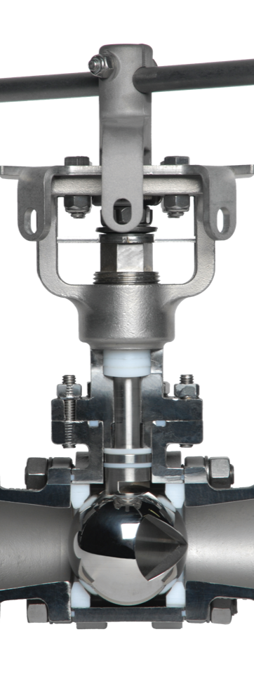

Lockable Tee Handle Option
Clearview Mounting Pad
Upper Shaft Guide
(not visible)
Independently Live
Loaded Upper Packing
Extended Bonnet for Insulation
Optional Fugitive Emission Port
(not visible)
Lower Shaft Guide
Independently Live
Loaded Lower Packing
Fully Encapsulated End Cap Seals
Wide Variety of Seat Options
Fully Grounded Shaft, Ball & Body
Complete Range of Body & Trim Materials (incl. High alloys)
Multiple End Connections (incl. flanged, welded, threaded, sanitary or customer specific)
Live Loaded Body Studs
S-CLASS
CUSTOM SOFT SEATED

Slide 5
Shaft Sealing System
^{Dual live loaded packing sets}
^{Upper and lower shaft guides}
Independent packing adjustments
S-CLASS
“THE BUCK STOPS HERE”
CUSTOM SOFT SEATED
Notes:
Shaft Sealing System:
The Gosco shaft sealing system is designed to all but eliminate shaft leaks. We stand behind it with our 1,000,000 cycle warranty
Dual live loaded packing sets:
Gosco’s soft seated valves have two sets of packing - graphoil or chevron Teflon at the top, and the patented Sealmaster on the bottom. Both are “Live loaded” for longer life
Upper and lower shaft guides:
We also have shaft guides because on a floating ball design, the line pressure forces the ball in to the downstream seat. This movement of the ball gets transferred to the shaft and in conventional ball valves, it creates “side load” on the packing. The shaft guides prevent the shaft from shifting and then compressing the packing. This is done by holding the shaft concentric and limiting packing side load). It dramatically increases packing life.
Independent packing adjustment:
Each packing set is independently adjustable to optimize the life of each packing.

Slide 6
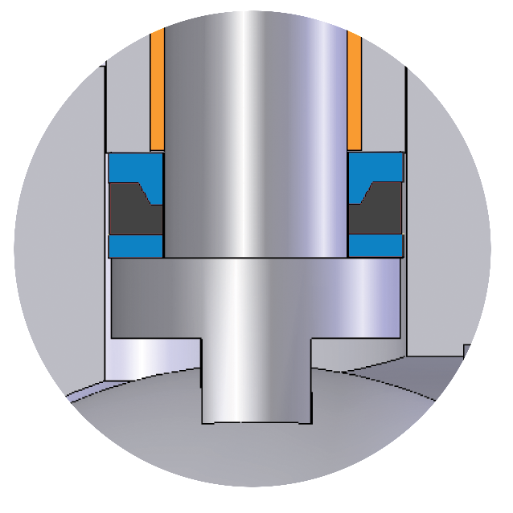
Sealmaster Shaft Seal
^{Patented design}
TÜV approved for fugitive emissions
^{1,000,000 cycle guarantee}
Upper Shaft Seal (Teflon, Devlon or PEEK)
Compression Ring (metal)
Lower Thrust Seal (Teflon, Devlon or PEEK)
S-CLASS
“THE BUCK STOPS HERE”
CUSTOM SOFT SEATED
Notes:
Sealmaster Shaft Seal:
The Sealmaster shaft seal is a unique seal that is offered on all our soft seated valves. It is comprised of 3 parts - Upper shaft seal, compression ring and a lower thrust seal. When the Sealmaster shaft seal is tightened, the compression ring (which is stainless steel) forces the upper shaft seal (Teflon or PEEK) against both the shaft and the body. It creates a seal between the shaft and body. The Sealmaster shaft seal can be retightened to recommended torques.
Patented Design:
The “Sealmaster” is patented by Gosco Valves because of its unique features that give it such long life.
TÜV approved:
It is live loaded and has been tested by TÜV to be better than a bellows seated valve (Copy of the certificate can be provided). It exceeds all current and proposed fugitive emission standards.
1,000,000 cycle guarantee:
The shaft sealing system (upper packing, sealmaster, shaft guides and live loading) prevents media from leaking out of the shaft. The combination of the “Sealmaster” and upper packing allows us to give a 1,000,000 cycle guarantee against packing leaks. We are the only company in the world to offer this guarantee.

Slide 7
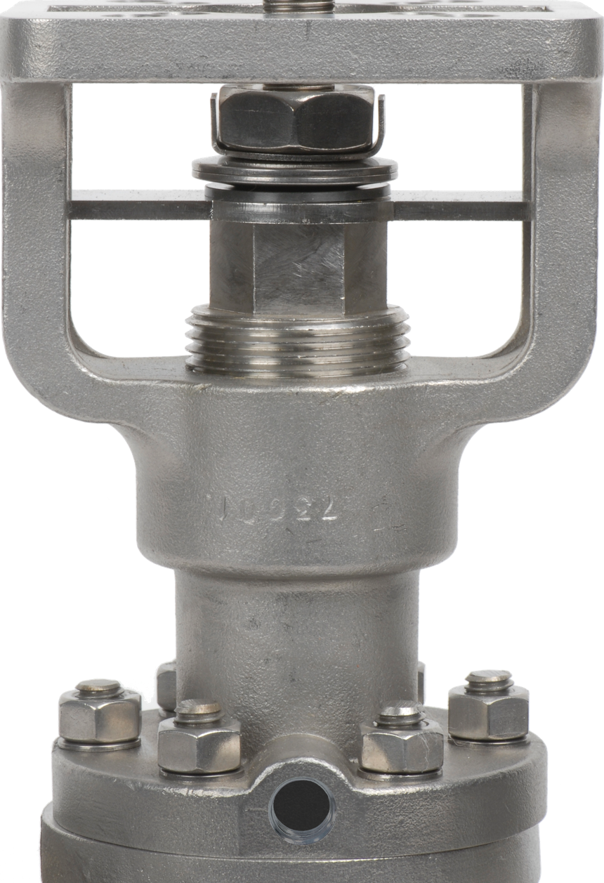
Fugitive Emissions Port
Located between upper/lower packing
^{Emission level monitoring}
^{Purgeable}
“TEST THE WATERS”
Notes:
Fugitive Emissions Port:
The fugitive emissions port allows controlled monitoring of fugitive emissions
Located between upper/lower packing:
The fugitive emission port is located between the upper and lower packing because when the lower packing leaks, it will be detected before it leaks to atmosphere.
Emission level monitoring:
A sniffer can be used to test emissions.
Purgeable:
The fugitive emissions port can also be pressurized with an inert gas for “zero emission” applications. A pressure switch on the purge port allows you to detect any packing leaks.

Slide 8
Extended Bonnet
Handle / actuator is outside the insulation
Packing adjustments are outside the insulation
IF the packing leaks, it is visible (outside the insulation)
^{Protects the operator}
S-CLASS
“A TALL DRINK OF WATER”
CUSTOM SOFT SEATED
Notes:
Extended Bonnet:
All Gosco’s soft seated valves have an extended bonnet. It has several advantages.
Handle / actuator is outside the insulation:
The actuator is raised away from elevated process conditions and is protected from excessive heat.
Packing adjustments are outside the insulation:
This allows full accessibility to the packing adjustments without removing the insulation
IF the packing leaks, it is visible (outside the insulation)
Even with our 1,000,000 cycle guarantee, eventually every seals leaks. With standard valves and extended handles, when the packing leaks, it leaks in to the insulation and can not be seen until it has saturated the insulation. This often becomes a fire hazard.
Protects the operator:
The metal cover around the insulation is not left exposed with sharp edges that can cut an operator if he needs to open or close the valve.

Slide 9
Clearview Mounting Pad
Dual ISO 5211 mounting patterns
^{Shaft flats visible}
Packing adjustments above insulation
Acts as a heat sink for actuator
S-CLASS
“I CAN SEE CLEARLY NOW”
CUSTOM SOFT SEATED
Notes:
Clearview Mounting Pad:
The Clearview mounting pad is designed to eliminate the problems with traditional mounting pads. It is a unique design, patented by Gosco Valves
Dual ISO 5211 mounting patterns:
On most sizes, we offer dual ISO 5211 mounting configurations
Shaft Flats visible:
The “Double D” stem indicates the valve position and is visible even if an actuator or insulation is installed.
Packing adjustments above insulation:
Packing adjustments are located above the insulation to allow full accessibility without removing the actuator or the insulation.
Acts as a heat sink for actuator:
The actuator is raised away from elevated process conditions and is protected from excessive heat or cold.

Slide 10
High Alloy Body / Ball Options
^{Monel}
^{Inconel}
^{Tantalum}
^{Incoloy}
^{Customer Specified}
^{Hastelloy}
^{Alloy 20}
^{Titanium}
^{Zirconium}
^{Duplex/Super Duplex}
S-CLASS
“CHAMELEON”
CUSTOM SOFT SEATED
Notes:
High Alloy/Body Ball Options:
Valves in corrosive applications sometimes require extra care, especially when selecting suitable materials. We have listed a few examples of materials that we have offered in the past. We can offer valve trim (ball and shaft) in any commercially available metal (see the list above). Our standard options for body material are: 316L stainless, Alloy 20, Duplex stainless (SMO 254) and Hastelloy C276. Gosco has lots of experience selecting the correct materials of construction for these applications.

Slide 11
Standard Vari-V Balls
^{high turndown V}
^{90˚ V ball}
^{linear V}
^{filler V}
^{10˚ V ball}
^{60˚ V ball}
^{30˚ V ball}
S-CLASS
“CONTROL FREAK”
CUSTOM SOFT SEATED
Notes:
Gosco Vari V Balls:
The Vari-V balls shown above are our standard product offering. The most common balls are 10, 30, 60, and 90 degree Vari-V balls, and all are available at the same price. Every Vari-V ball is cut precisely to satisfy flow control requirements.

Slide 12
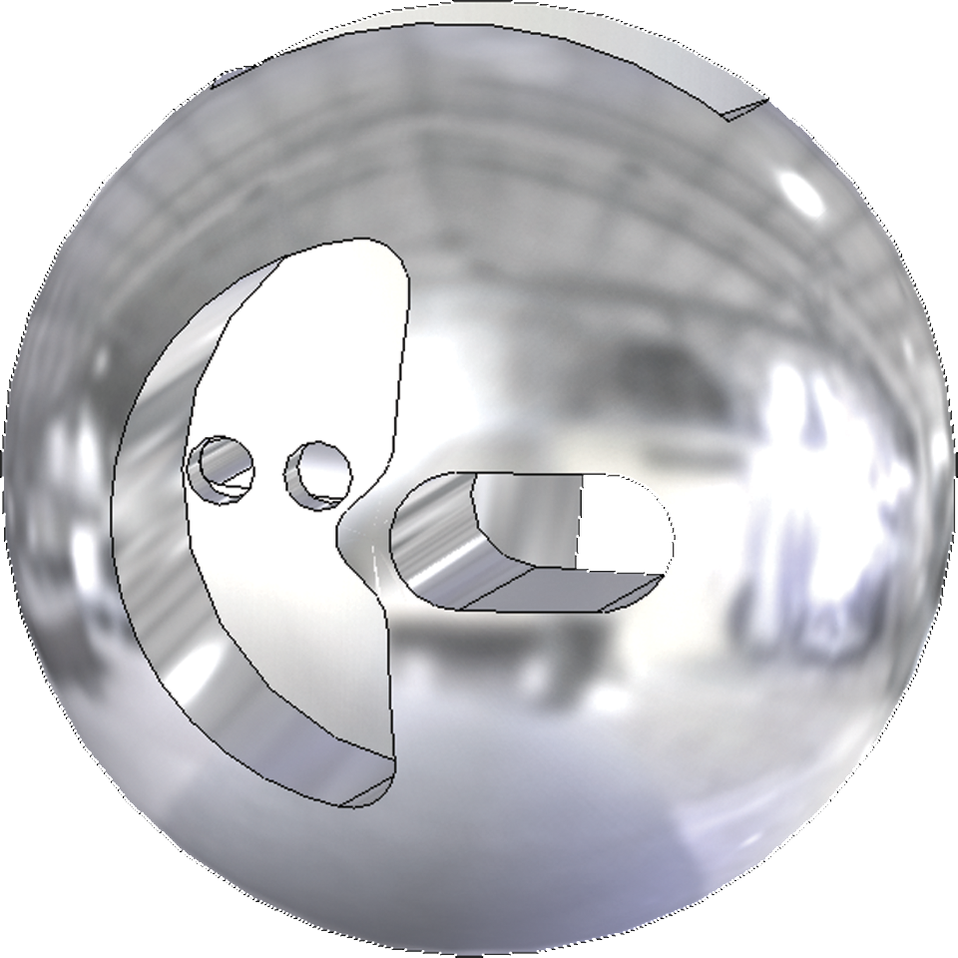

Custom Vari-V Balls
Gosco can custom design any profile for your application
S-CLASS
“CONTROL FREAK”
CUSTOM SOFT SEATED
Notes:
Custom Vari V Balls:
We are not restricted to just the 7 standard Vari-V balls.
Gosco can custom design any profile for your application:
We also design non-standard Vari-V balls which entails a very special profile cut into the ball. We do a complete CFD (Computational Fluid Dynamics) analysis on the flow requirements and custom design the V ball to meet your exact requirements. This ball was designed for a customer to eliminate cavitation and also give him a very specific flow characteristic. We can also manufacture balls with slots in them that are slightly larger than the diameter of a human hair.

Slide 13
Custom V-ball Cv Curve
Cv
Slot opening is almost as thin as a human hair
% open
Flow requirements for one of our custom V-balls.
S-CLASS
“CONTROL FREAK”
CUSTOM SOFT SEATED
Notes:
Custom V-ball Cv curve:
This is an example of a custom V ball requirement. The customer (Dupont) asked for this specific flow characteristic, and we made a valve to suit his needs. To give you an idea of how custom this particular ball valve was, the flow conditions have about a 580 to 1 turndown. This is unheard of in the ball valve industry.

Slide 14
Ball Hardening Options for Abrasive/High Cycle Applications
High Velocity Oxygen Fuel (HVOF)
^{Boronizing}
^{Ceramics}
S-CLASS
“HARD ASS” or “NOT IT’S ALL CRACKED UP TO BE”?
CUSTOM SOFT SEATED
Notes:
Ball Hardening Options for Abrasive/High Cycle Applications:
Although this style of valve is primarily designed for soft seated applications, we do offer hardened balls for all sizes.
High Velocity Oxygen Fuel (HVOF):
HVOF is a thermal spray coating method that applies powdered metal on a part using a high velocity gas carrier, assisted by an oxygen flame.
Boronizing
Boronizing is a much more expensive diffusion process that is done on both the ball and seats and is used on abrasive or high cycle applications. The base material we use is Inconel because of its hardness and stability at high temperatures.
Ceramics:
Ceramics are used as an alternative to boronized Inconel for extreme abrasive or corrosive applications

Slide 15
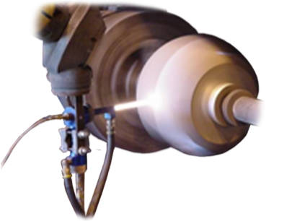
Competition - HVOF
High Velocity Oxygen Fuel
Uneven coating (line of sight)
Cracks / spalls
Coating is porous
Internal bore of ball can not be coated
S-CLASS
“NOT ALL IT’S CRACKED UP TO BE”
CUSTOM SOFT SEATED
Notes:
Competition – HVOF
High Velocity Oxygen Fuel:
HVOF (High Velocity Oxygen Fuel) is a thermal spray coating method that applies powdered metal on to a part using a high velocity gas carrier, assisted by an oxygen flame. This is the process that most metal seated valve manufacturers use for hardening trim sets.
Uneven coating (line of sight):
One of the drawbacks of coatings is that complex geometries are difficult to coat using the HVOF method because the application is line of sight. Metallurgical bonding of the sprayed metal is limited because the sprayed metal is generally not fused to the base metal in this method. Grinding the overspray requires substantial work to arrive at the desired dimension and finish.
Cracks / spalls:
If you take an egg out of the fridge and drop it immediately in to boiling water, the shell will crack. This is because the shell is expanding at a different rate to the yolk and white of the egg. A similar thing happens with coatings because they have different expansion rates. The expansion and contraction, combined with high pressures on the ball and seats is what causes the coatings to crack. We do not recommend coatings on high temperature, high pressure or abrasive applications.
Coating is porous:
Another drawback of coatings is that they are porous. If the media in the line is not compatible with the base material of the ball and seats, you will get corrosion from the inside out.
Internal bore of ball can not be coated:
Generally, the HVOF coating just covers the leading edge of the ball, and does not go in to the internal bore. This makes the ball very subject to spalling. Sometimes the bore is coated, but on smaller sizes, it is physically impossible to get the nozzle of the gun in to the bore and therefore can not be done.

Slide 16
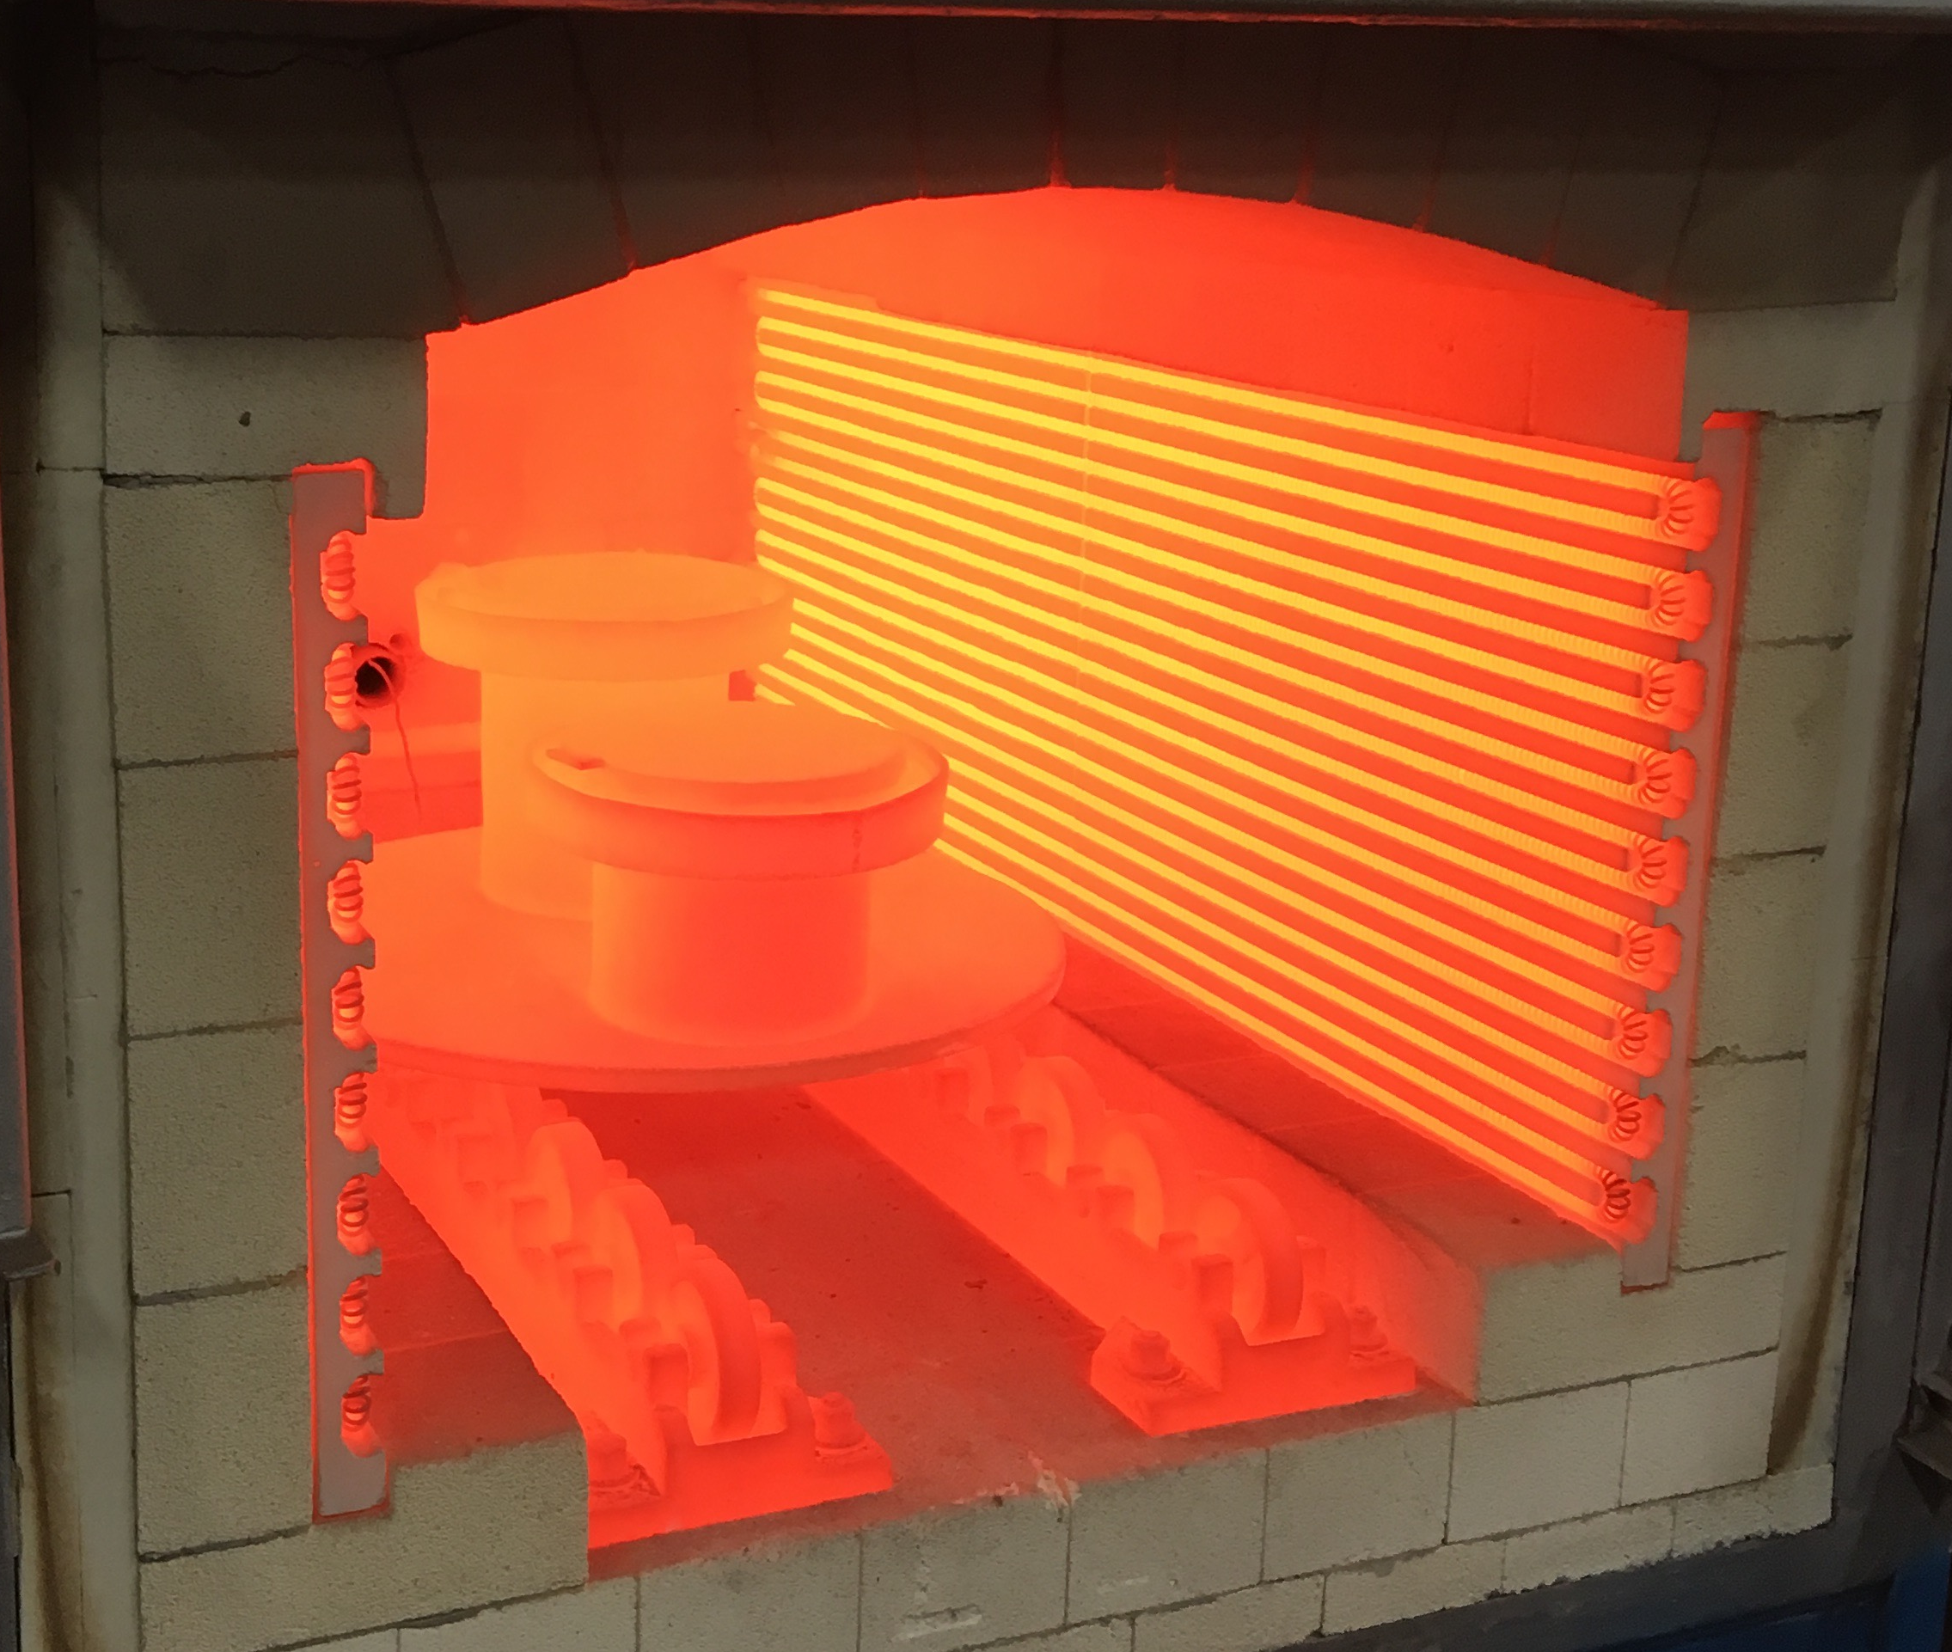
Gosco Boronizing
S-CLASS
“HARD ASS”
CUSTOM SOFT SEATED
Notes:
Gosco – Boronizing:
This is a picture of two retorts containing a 3” trim set in each. They are at 1800F

Slide 17
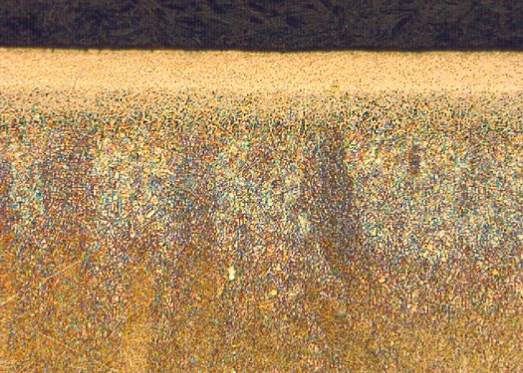
Gosco Boronizing
Proprietary Gosco Process
Thermo-chemical surface hardening process
Boron atoms are diffused into the surface
Results in a case layer that is extremely hard, corrosion resistant, and capable of handling high temperature shocks
Inconel 718, 200x magnification
.004” solid layer, .007” partial layer
S-CLASS
“HARD ASS”
CUSTOM SOFT SEATED
Notes:
BORONIZING:
Boronizing is the standard hardening process Gosco uses for our trim sets.
Proprietary Gosco Process
This is our proprietary process which cost hundreds of thousands of dollars to develop. The recipe is completely different from traditional boronizing processes, and we spent years working on processing times, temperatures, and variations to the recipe to give us a surface layer and hardness that have never been achieved before.
Inconel 718, 200x magnification 0.0035” solid layer, 0.007” partial layer:
This is a 200 times magnification of a cross section of Inconel 718 that has been boronized. You can clearly see the hard solid layer and then the roots extending into the base material. This prevents spalling and flaking. The hardness of the boride layer is off the Rockwell C scale. The core hardness is 43 RC, so it is can be used in NACE applications.
Thermo-chemical surface hardening process:
It is important to note that this is a chemical process, not a coating.
Boron atoms are diffused in to the surface:
The only commonality between our recipe and the competitions’ is the boron element. We use completely different carriers and activators. Because of our process, we create an extremely hard outer layer that is almost a monolyth. We can achieve layer depths without spalling that are approaching the thickness of traditional coatings.
Results in a case layer that is extremely hard, corrosion resistant, and capable of handling high temperature shocks:
This process is much more advanced than any type of coating and costs considerably more money because of the quality of the base metals we use. It results in a product that outlasts any of the competition.

Slide 18
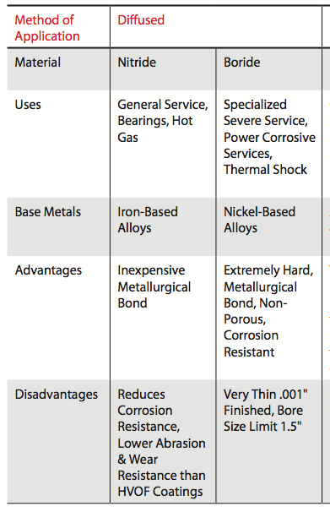
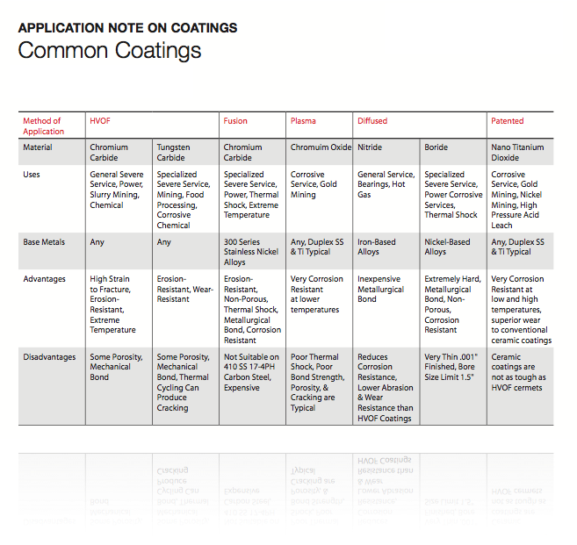
Competitor about “Coatings”
“NOT ALL IT’S CRACKED UP TO BE”
“HARD ASS”
Notes:
Competitor on coatings:
This chart came off the Mogas web site.
HVOF:
High Velocity Oxygen Fuel
Uses:
They state that HVOF coatings are for general severe service applications in all industries.
Advantages:
High strain to fracture means that HVOF coatings have good elasticity. Therefore, a high strain needs to be placed on them before they deform beyond their elastic limit and break. They are also erosion resistant because the chromium carbide is very hard (generally the harder the material, the better the wear resistance). As well, chrome carbide is the best coating material for high temperatures.
Disadvantages:
They are porous, so the process can get through the coating and cause the mechanical bond to break apart. Also, because it is a mechanical bond, there is no penetration of the base metal. There is a possibility of the coating separating from the base material if the bond is not strong enough.
Diffused:
This is a thermo chemical process rather than a coating process
Uses:
Mogas states that boronizing is for specialized severe service applications. This indicates that they can also be used in general servere service applications too. As well, they mention corrosive services. This is because Inconel is much more corrosion resistant than 410 stainless (which is the most common base material used in HVOF coatings). Thermal shock is another advantage of boronizing because both the base metal and the hardened layer have the same coefficient of expansion and will not crack or spall.
Advantages:
Boronizing is harder than any HVOF coating. This makes it very abrasive resistant. Also, it is a metallurgical bond, so the actual structure of the base metal has been changed. This means there is no chance of spalling because it is a homogeneous material. As well, the boronizing actually creates a monolyth that is more corrosion resistant than the base metal (Inconel 718 – that is already extremely corrosion resistant).
Disadvantages:
Mogas states that it is very thin, so it is easy to break through the hard outer layer. Also, Mogas is unable to boride sizes over 1 1/2”. We will address these “Disadvantages” in the next slide.

Slide 19
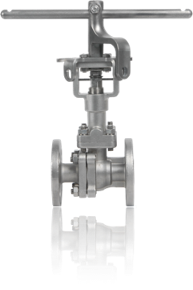
Gosco’s Proprietary Boronizing Process
0.004” to 0.007” depth
No size limit
Considerably harder than any coating
All the advantages, no disadvantages
S-CLASS
“THE REAL DEAL”
CUSTOM SOFT SEATED
Notes:
Gosco’s Proprietary Boronizing Process:
As I mentioned in previous slides, Gosco Valves has developed their own boronizing process. It is our proprietary recipe and we keep this secret. We mix the powders, prepare the parts and load the retorts in-house. Then we send the retorts to a third party for firing at our temperatures and durations. Gosco has signed non-disclosures with our third party heat treaters and they are not allowed to open the retorts unless a Gosco employee is present. This is why our trim sets last longer than both HVOF processes and other boronizing processes
0.004” to 0.007” depth:
Unlike the competition, our proprietary boronizing process allows us to get a very deep borided layer (5 times deeper than traditional boronizing). This is important because it improves the life expectancy of the valve. Typical coatings are 0.005”to 0.01”
No size limit:
Unlike the competition, Gosco is able to use boronizing on our complete line of valves.
Considerably Harder than any coating:
The Gosco boronizing is considerably harder than any coating. The hardest coating is tungsten carbide with a Rc of 70-75. Our surface layer is so hard it can’t be measured on the Rc scale and we need to use the Vickers or Knoop scale. We typically see hardnesses in the range of 2400HV to 2700HV.
All the advantages, no disadvantages:
Gosco offers the best of both worlds – all of the advantages of boronizing over HVOF, we get a very deep case layer, and have no size limit

Slide 20
Alumina / Zirconia based Ceramic
^{Extreme abrasion resistance}
^{Corrosion resistance}
Dimensional stability at high temperatures
^{Expensive}
^{150˚F temperature shock max}
^{Low tensile/shear strength}
S-CLASS
“HARDER ASS”
CUSTOM SOFT SEATED
Notes:
Alumina/Zirconia based Ceramic:
There are many different grades of ceramic available. The one we have picked as our standard is an alumina/Zirconia based ceramic that is extremely abrasive resistant
Extreme abrasion resistance:
Ceramics in general are very good on abrasive applications. This grade of ceramic was developed specifically for abrasive applications.
Corrosion resistance:
Ceramics are also extremely corrosion resistant. In many cases, they work better than Hastelloy, Monel and titanium etc
Dimensional stability at high temperatures:
The coefficient of expansion of ceramics is very low, so they do not expand very much with heat. This is important because the ball will not distort when heated and cooled
Expensive:
As with everything, there is a cost/benefit trade-off. With high abrasion resistance comes cost!
150ºF temperature shock max:
Although there are grades of ceramic that can tolerate a 200ºF, this particular grade is designed for abrasion resistance and will only tolerate 150ºF temperature shocks. We can provide other ceramics for temperature shocks.
Low tensile/shear strength:
Whilst ceramics have very high compressive strength, they do not work well under shear. Therefore, they are not suited to compnents like stems.

Slide 21
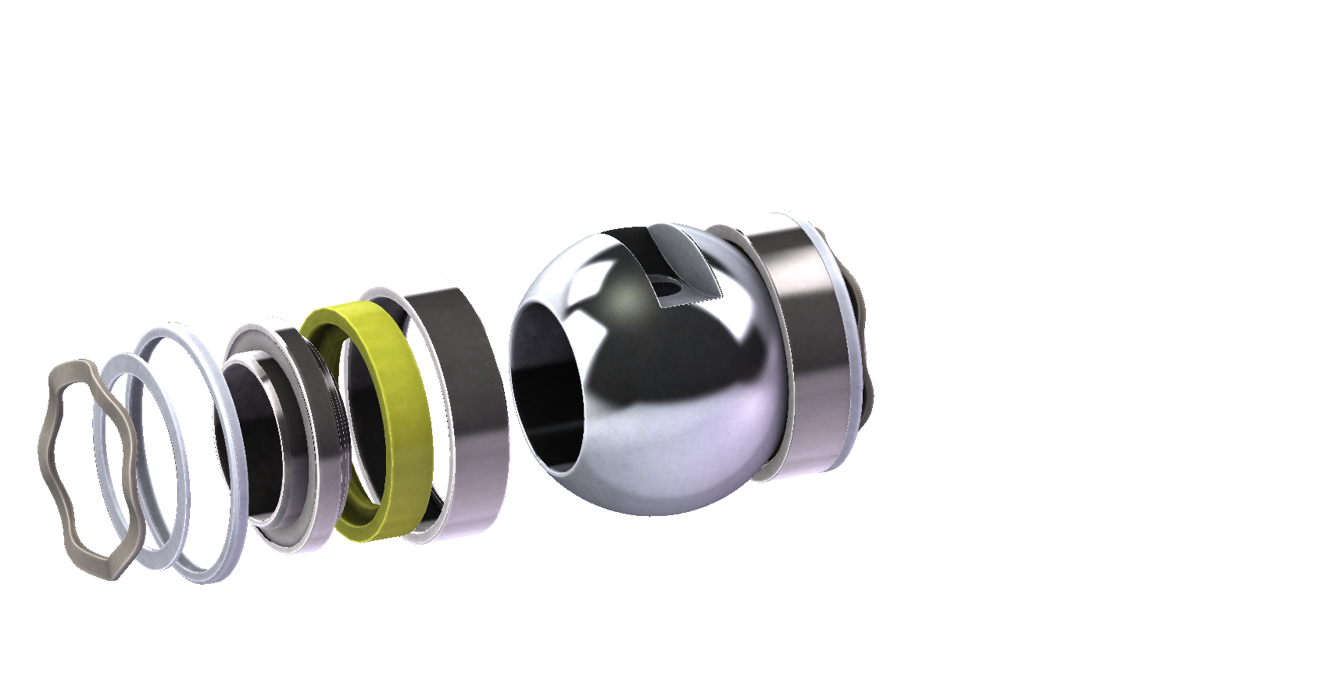
Encapsulated Seats
Inner Carrier encapsulates the seat insert on the inner circumference
Seat Insert seals against the ball
Spring loaded Outer Seal provides sealing on the seat assembly circumference
Outer Carrier encapsulates seat insert on the outer circumference
Compression Ring for API 607 fire-safe applications
Wave Spring provides ”Live-load” on the seat assembly
S-CLASS
“STRAIGHT JACKET”
CUSTOM SOFT SEATED
Notes:
Encapsulated Seats:
Gosco Valves has developed their own encapsulated seats for abrasive and high pressure & temperature applications.
Wave Spring provides “Live-load” on the seat assembly:
For low pressure applications, the spring gives the initial load on the seats to seal. Pressure assists the seal. In cryogenic applications, the wave spring provides pressure relief in the cavity and therefore we can provide a bi-directional cryogenic valve instead of a drilled ball.
Compression Ring for API 607 fire-safe applications:
The Compression Ring is designed to melt away in a fire and allow the spring pressure to be relieved. This way the seats can float and make metal-to-metal contact with the flanges, creating a seal for API607 purposes.
Spring loaded Outer Seal provides sealing on the seat assembly circumference:
The Outer Spring seal has an internal spring that makes it pressure assisted. Therefore, it can be used in very high pressure applications. It seals the outer circumference of the carrier as well as between the back of the carrier and the valve body.
Inner Carrier encapsulates the seat insert on the inner circumference:
This prevents the “Soft” insert from distorting
Seat Insert seals against the ball:
Seat Inserts can be made of different materials depending on the application
Outer Carrier encapsulates the seat insert on the outer circumference:
This prevents the “Soft” insert from distorting

Slide 22
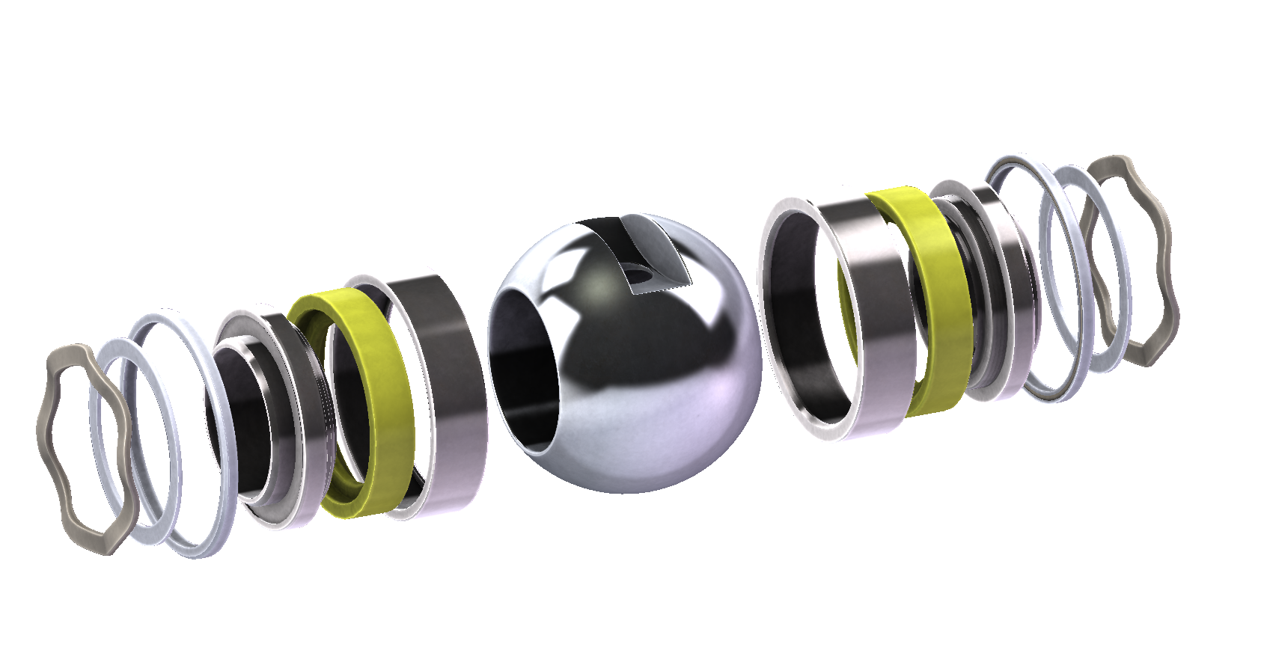
Encapsulated Seats
Proprietary Gosco Design
Live-loaded for sealing at low pressures
Utilized in high temperatures and/or pressures
Encapsulates “Soft” insert on all 4 sides
S-CLASS
“STRAIGHT JACKET”
CUSTOM SOFT SEATED
Notes:
Encapsulated Seats:
Gosco Valves has developed their own encapsulated seats for high pressure and temperature applications.
Proprietary Design:
Unlike the competition, the encapsulated seats were designed and tested in-house. We have never copied a design from another company.
Encapsulates “Soft” insert on all 4 sides:
The unique design and manufacturing process allows us to completely encapsulate the “soft” (Devlon, Teflon, PEEK etc) insert so it does not “Cold Flow”.
Live-loaded for sealing at low pressures:
We offer both bi-directional and uni-directional designs for low pressure sealing. The design can also be used on cryogenic valves where pressure build-up in the ball and body cavity need to be released.
Utilized in high temperatures and/or pressures:
We can typically get 50ºF higher temperatures out of the “Soft” materials because of the design. More importantly we can use this design on extreme pressures that normally crush “soft” materials

Slide 23
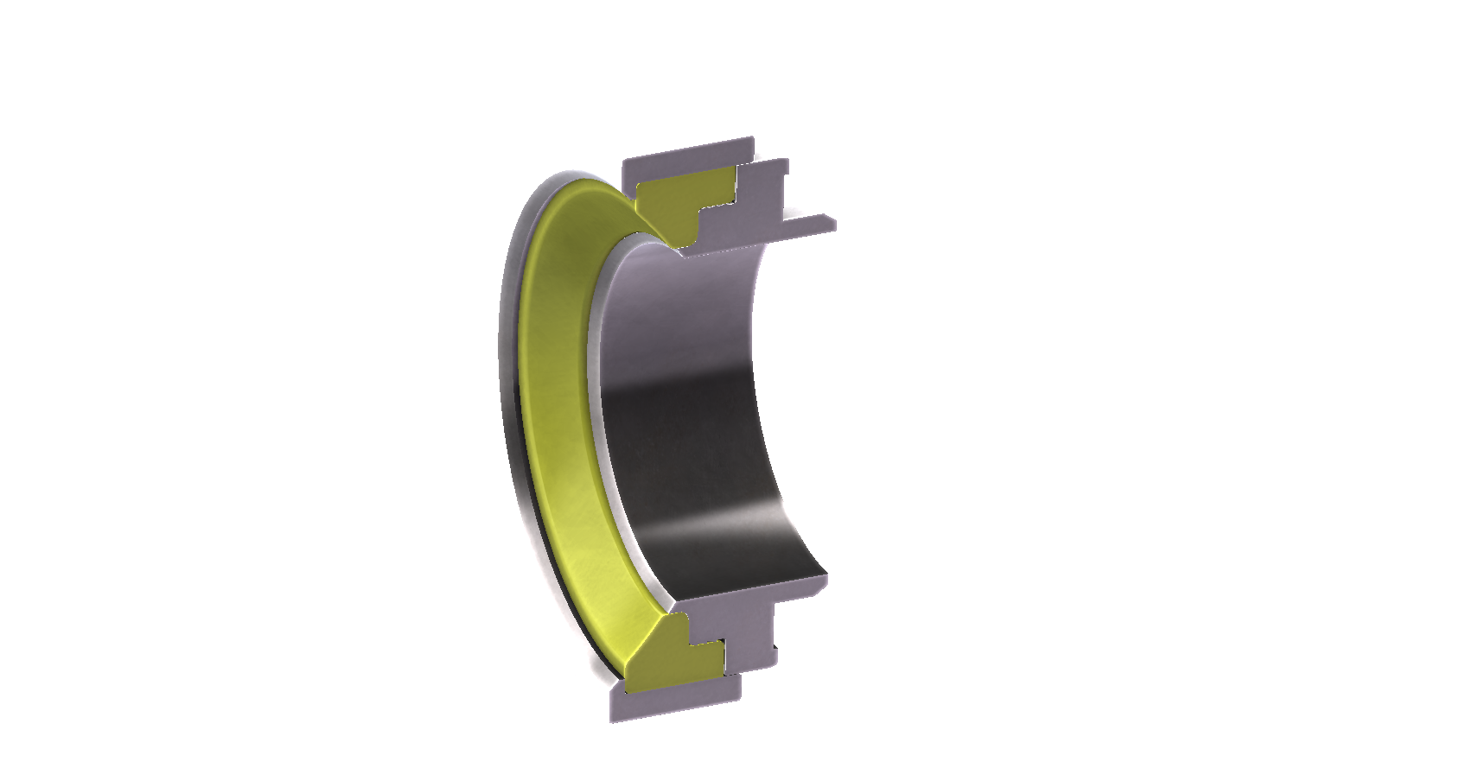
Encapsulated Seats
Encapsulates “Soft” insert on all 4 sides
S-CLASS
“STRAIGHT JACKET”
CUSTOM SOFT SEATED
Notes:
Encapsulated Seats:
Gosco Valves has developed their own encapsulated seats for high pressure and temperature applications.
Encapsulates “Soft” insert on all 4 sides:
Unlike the competition, Gosco’s encapsulated seats completely contain the “Soft” insert. There are even teeth to prevent it from extruding.
This is especially important in high pressure applications where “Soft” materials tend to find ways to extrude out of the containment. We have tested these seats in pressures exceeding 15,000psi.
The same applies to high temperature applications where heat softens the “Soft” material and makes it more prone to “Cold Flow”. Gosco’s encapsulated seat design gives us an additional 50ºF in the upper temperature limit.

Slide 24
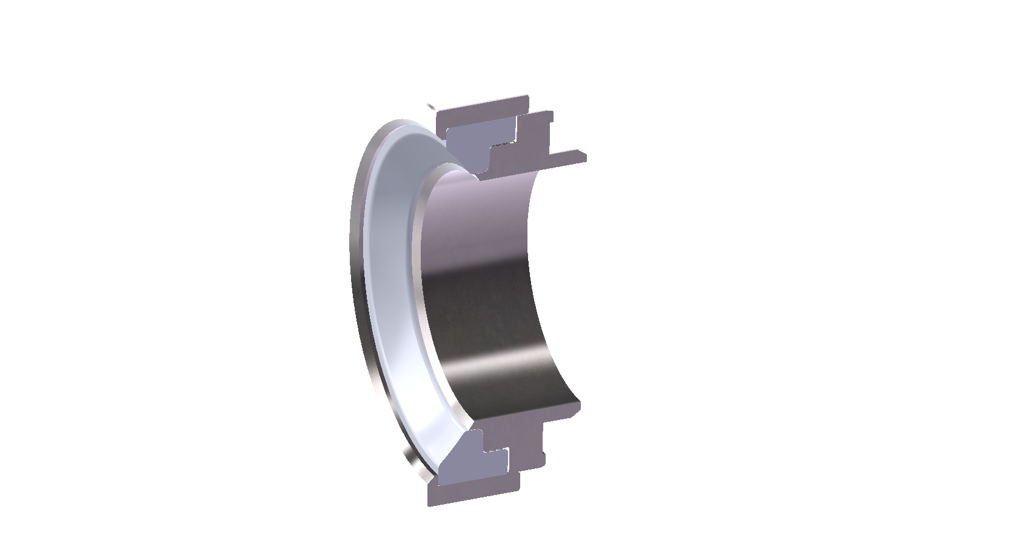
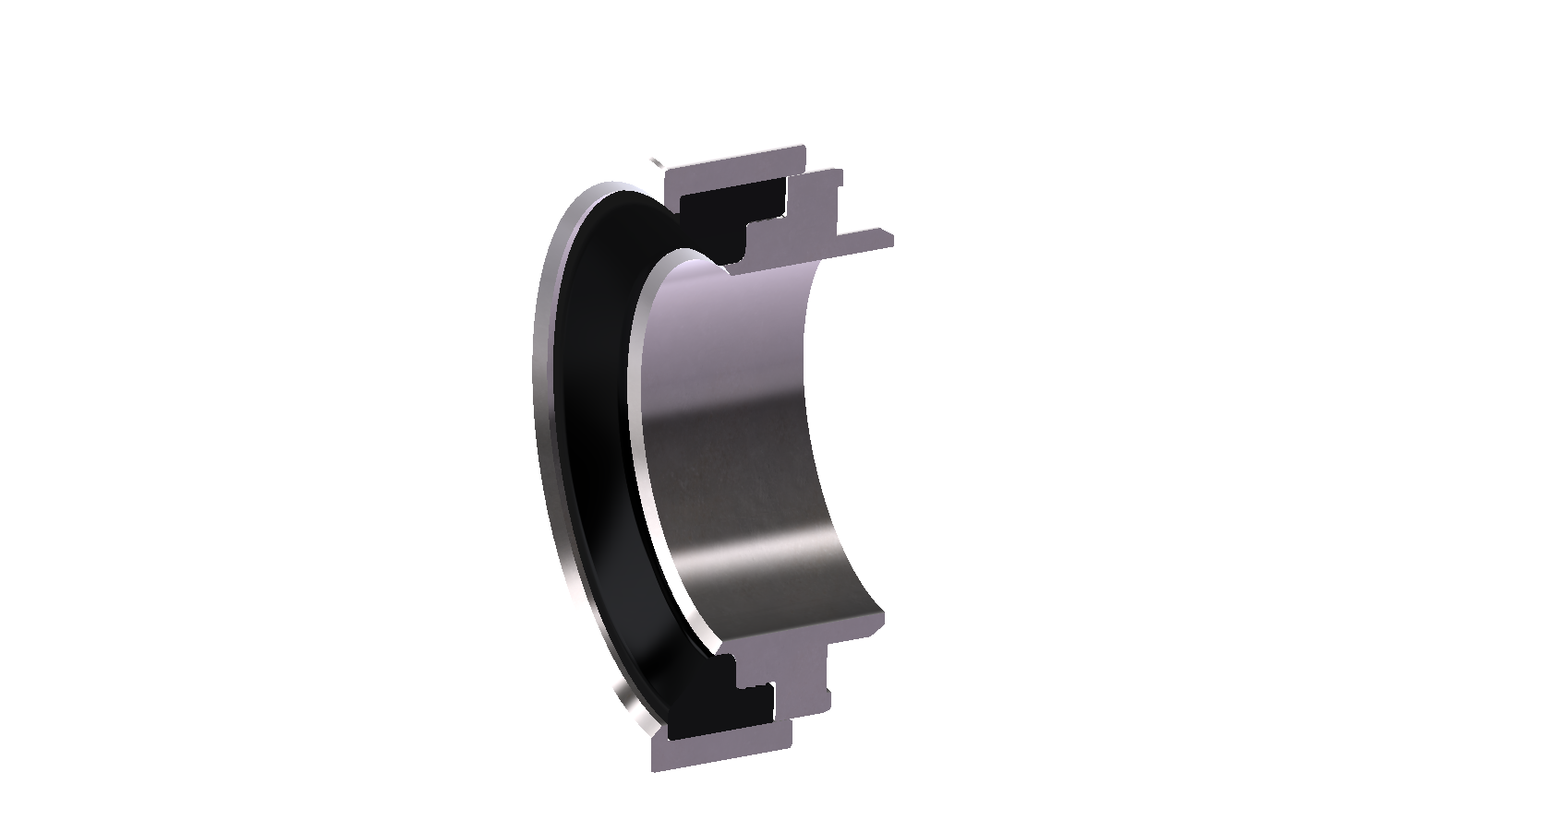
Encapsulated Seats
Teflon/TFM 1600 (Standard applications)
Devlon (Abrasive/High cycle applications)
PEEK/Graphite (High temperature applications)
“Soft” insert can be different materials depending on the application
S-CLASS
“STRAIGHT JACKET”
CUSTOM SOFT SEATED
Notes:
Soft Insert can be different materials depending on the application:
As with most encapsulated seats, the insert can be changed out depending on the application.
Teflon/TFM 1600 (Standard applications):
Teflon or TFM 1600 is excellent for corrosion and sealing at low pressures. Encapsulating it protects it from high velocities and allows us to go to higher pressures than standard Teflon seats.
Devlon (Abrasive/High cycle applications):
Devlon is EXTREMELY wear resistant and in many cases works better than metal seats (when coupled with a boronized Inconel ball with an arcuate cut). It is also exceptional for high cycle applications.
PEEK/Graphite (High temperature applications):
PEEK and Graphite inserts are used for high temperature applications because the carrier holds them in place so they don’t ”Cold Flow”. We can typically get 50ºF higher temperatures out of the “Soft” materials because of the design.

Slide 25
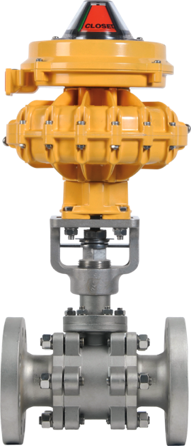
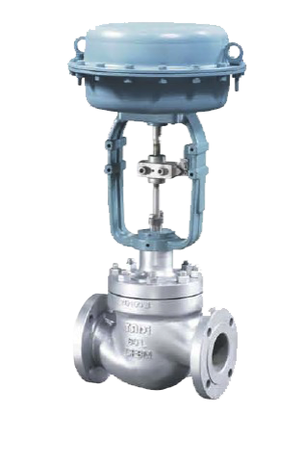
Gosco Vari-V Vs Caged Globe Valve
Cost
Repairs
Versatility
Functionality
Precision
S-CLASS
CUSTOM SOFT SEATED

Slide 26
Caged Globe Valve
Costs 50% more upfront
Requires the purchase of additional ball valves on either end for isolation purchases
Repair costs significantly higher
  Machinery & lifts are required to service it
  Assessment fees of $1500+
  Specialist is needed to perform work
S-CLASS
CUSTOM SOFT SEATED

Slide 27
Vari-V Control Ball
Significantly less expensive “Cost of Ownership”
Dual functionality: Control flow AND isolate flow
Repair work is cheaper and faster
  Vari-V ball valves can be replaced or
  repaired by internal workers
  Only costs are the replacement parts
  themselves
S-CLASS
CUSTOM SOFT SEATED

Slide 28










Satisfied Gosco Customers
Notes:
Noranda: Northern Quebec uses our valves on cement slurry
Bayer: Houston, Texas uses our metal seated valves on a chemical application where the media is abrasive and tends to harden if it is not moving. We designed seals to contain the belleville washers and prevent the media from getting behind the seat
Exxon: Baytown and Beaumont, Texas uses Dual Paks and metal seated double block and bleed valves
NASA: Cleveland, Ohio uses Dual Pak’s with PEEK seats on their wind tunnel to simulate the shuttle’s return to the earth’s atmosphere
Dupont: Spruance, Virgina uses our valves on all “SV” (Special valve) applications. These include TiCl, sulphuric acid, DMAC, steam and other chemicals. In 8 years, we have still not had a packing leak.
ChevronPhillips: Orange, Texas uses our Dual Pak on high cycle silica (every 15 seconds). Our valves are lasting as average of 3 million cycles.
Texas Instruments: Dallas, Texas uses our valve to control caustic. Our competitors had stem leaks within weeks. The Vari V’s we installed are still not leaking after 6 years.
Husky Injection Moldings: Bolton, Ontario uses Dual Paks on their injection molding machines
ConocoPhillips: Lake Charles, Louisiana and Wood River, Illinois use our valves on their S Zorb system. It is extremely abrasive, 900F, 1000psi. Our valves have lasted 13 months to date and the competitors have been replaced on average every 2 1/2 months
General Electric: Greenville S.C. uses our valves on turbine exhaust systems at 1000F, 1000psi. 4 years without leaks

Slide 29

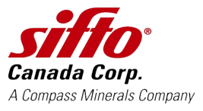




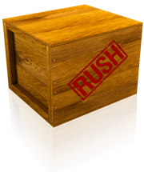

Why use Gosco’s Vari-V Ball Valves?
Customization
  For unusual applications, our engineers will custom design the most suitable ball profile
Speedy Deliveries
  Lead times as fast as 1-2 weeks
Proven Track Record
  Used by recognized companies in a wide range of industries including chemical, food, mining, process, and pulp & paper
Port Colborne Smelter
S-CLASS
CUSTOM SOFT SEATED

Slide 30
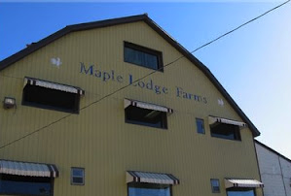

Success Story
Brampton, Ontario
Gosco Valves supplied 15 valves to Canada’s largest independent chicken processor, replacing Samson globe valves and Worcester valves, both failed after 3-4 months in use, and Starline valves, which leaked after 4-5 months in use. After 18 months, the Gosco S-Class valves remain maintenance free, and have had no leaks through the seat or packing.
S-CLASS
CUSTOM SOFT SEATED

Slide 31


Success Story
^{SUDBURY, CANADA}
A number of Gosco Vari-V valves have been installed to process high temperature heat around the nickel smelting process. Our 1/2” and 3/4” metal and soft seated valves have replaced numerous Fisher control valves at this location.
S-CLASS
CUSTOM SOFT SEATED

Slide 32



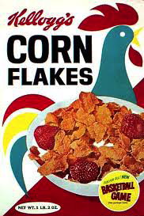
Success Story
London, ON
Gosco Vari-V valves replaced Fisher Caged Globe valves at the Kellogg’s plant. Due to the nature of Caged Globe valves, only our S-Class valves could isolate/shut down the system.
Reserve, TX
Gosco supplied a fabricated Hastelloy C276 valve, complete with a specific profiled Vari-V ball made out of Tantalum, to E.I. DU PONT DE NEMOURS AND COMPANY
S-CLASS
CUSTOM SOFT SEATED

Slide 33
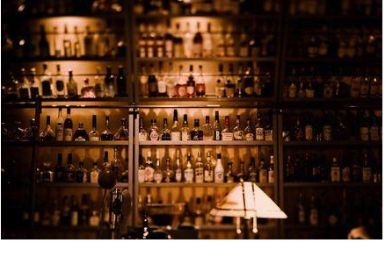

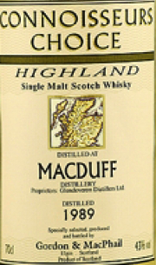
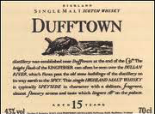
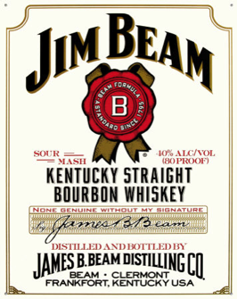
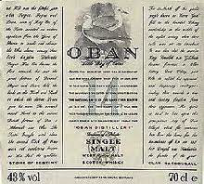
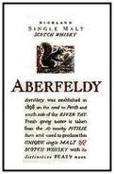
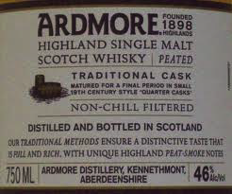
Satisfied Vari-V Customers
Distilleries
  Several 1/2” to 4” 150# 60° Vari-Vs in UK distilleries
S-CLASS
CUSTOM SOFT SEATED

Slide 34
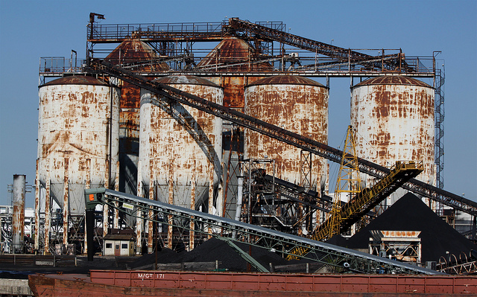
Metal Seated Successes
We replaced a 2" (300#) VTI (Valvtechnologies) control valve at Pasadena Refining Systems Inc. in Pasadena, TX which had a Fisher actuator/positioner.
VTI: $ 11,000 – 316 body, 316 with QPQ trim set
Gosco: $ 11,700
We used a borided Inconel trim set, standard port, Kinetrol act, Fisher positioner (was free issued by PRSI).
VTI valve was lasting 3-4 months. Gosco valve lasted more than a year.
S-CLASS
CUSTOM SOFT SEATED

Slide 35
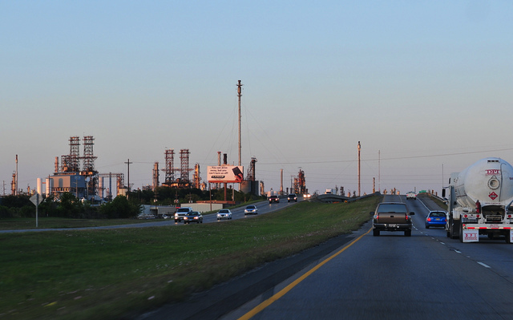
Metal Seated Successes
We replaced a 2" (300#) VTI (Valvtechnologies) control valve at Conoco Phillips (Phillips 66) in Lake Charles, LA. Same VTI valve.
VTI: $ 11,000 – 316 body, 316 with QPQ trim set
Gosco: $ 12,800
We used a borided Inconel trim set, standard port, Kinetrol act, Fisher positioner.
VTI valve was lasting 3-4 months. Fisher was lasting 5 months (V200). Gosco valve lasted 16 months.
Fisher pricing was about $10,000 and was charging about $5,000 to repair (replace trim set) every 6 months.
S-CLASS
CUSTOM SOFT SEATED

